Slide 1

EVisionAI : Smart EV Station Finder with Real-Time Slot Forecasting
Bhushan Kokate (22106070)
Prathamesh Kulkarni (22106032)
Shreyas Joshi (22106006)
Siddhesh Kaware (22106053)
Project Guide
Prof. Taruna Sharma

Slide 2
Outline
Introduction
Literature Survey of the existing systems
Limitations of the existing systems
Problem statement and Objective
Proposed System
Experimental Setup(Details about input/ dataset, Performance evaluation parameters, Software and hardware setup)
Implementation(Screenshots of all modules)
Conclusion and future work
References
Research Paper Publication / Patent/ Copyright status

Slide 3
Introduction
EVisionAI is a web-based tool for planning EV trips. Enter your battery, charger
type, and destination, and it uses Google Maps to show routes with compatible
charging stations. Signed-in users get car details saved for faster use. The aim is
to ease range anxiety and save time with simple, integrated routing and
charger discovery.
Motivation :
EV users often struggle with range anxiety and charger discovery delays.
Existing apps provide either navigation or station lookup, but rarely both in one smooth interface.
Need for a simple web-based tool that integrates routing, station

Slide 4
Introduction
Objectives :
1. Provide real-time EV charging station discovery using mapping APIs.
2. Offer route planning with charger compatibility checks.
3. Enable guest and registered user modes:
4. Guests can explore
5. Registered users save preferences (car type, battery level, etc.).
6. Maintain a lightweight database for user/session management.
7. Deliver a clean, web-based interface accessible across devices.
Features :
Find charging stations – Shows nearby EV charging points on the map.
Plan routes – Helps plan long trips with charging stops along the way.
Guest & user access – Guests can explore, while registered users can save their car details.
Save preferences – Stores battery level, car type, and charger type for quick use next time.
Database support – Keeps user info and session data safe.
Simple web interface – Easy-to-use design that works on any device

Slide 5
Literature Survey of the existing system
Year | Title | Domain | Algorithm | Dataset | Gap
2024 | Stochastic modeling of multiple-server charging stations for electric vehicle networks using feedback strategies | EV charging station modeling with multi-server queueing theory and feedback control | Markovian queueing model with feedback mechanisms, Chapman–Kolmogorov equations, matrix-analytic solution | Theoretical/simulated data (no real-world dataset specified) | Lack of queueing models that incorporate feedback strategies in multi-server EV charging environments
2025 | Electric Vehicle charging station load forecasting with an integrated DeepBoost approach | EV charging station load forecasting | DeepBoost (hybrid of LSTM, XGBoost, CatBoost, Linear Regression) | Adaptive Charging Network (ACN), Palo Alto, and Perth charging station data (open dataset, GitHub repository available) | Existing forecasting models lacked hybrid ensemble approaches combining deep learning and boosting methods; DeepBoost improves accuracy significantly over individual models

Slide 6
Literature Survey of the existing system
Year | Title | Domain | Algorithm | Dataset | Gap
2024 | Planning of electric vehicle charging stations: An integrated deep learning and queueing theory approach | EV charging station location-capacity planning using deep learning and queueing theory | Deep learning–enhanced NSGA-II with queueing-theoretic waiting time estimation | Simulated data based on Halifax, Canada; bi-objective model using mixed-integer nonlinear programming | Traditional queueing models were inefficient—this integrated method improves computation time by 99.8%, reduces estimation deviation from 13% to 1.6%, and optimizes wait time vs. cost more effectively
2025 | An Intelligent System for Electric Vehicle Charging Station Discovery and Reservation Using Real-Time Data | EV charging infrastructure with real-time station discovery and slot reservation | Flask + Python backend for booking and user management; MySQL for real-time data handling; HTML/CSS for frontend | Real-time station data (simulated for districts in Kerala, India) and user booking records stored in MySQL | Existing systems only provide station locations without integrating real-time availability or reservation features; this work fills the gap

Slide 7
Literature Survey of the existing system
Year | Title | Domain | Algorithm | Dataset | Gap
2022 | Integration of EVs into the smart grid: a systematic literature review | EV-Smart Grid Integration / Energy Informatics | Analytical models, simulation (e.g. Monte Carlo) among others | 724 papers (260 from IEEE Xplore + 464 from Web of Science) | Lack of use of advanced analytics / ML / big-data methods for EV–smart grid integration.
2022 | Real-time optimization in electric vehicle stations using artificial neural networks | EV Charging / Smart Charging | Artificial Neural Network (ANN), Levenberg–Marquardt optimization | Simulated dataset of EV arrivals (154 EVs/day for 1 station, expanded to 770 EVs across 5 stations) | Integrated optimization (travel + queuing + charging) is underexplored

Slide 8
Literature Survey of the existing system
Year | Title | Domain | Algorithm | Dataset | Gap
2025 | Optimized planning of electric vehicle charging infrastructure for grid performance improvement | EV Charging Infrastructure / Grid Stability & Planning | Multi-objective Particle Swarm Optimization (MOPSO) | IEEE 69-bus system under different load scenarios (low, medium, high, overload) | Lacks integration of real EV user behavior, seasonal/long-term planning, hybrid or adaptive metaheuristic methods
2024 | A review of the electric vehicle charging technology, impact and infrastructure | A review of the electric vehicle charging technology, impact on grid | Survey | Review of existing literature on charging tech, grid impact, infrastructure | Need more real-world empirical studies; integration of renewables + storage

Slide 9
Literature Survey of the existing system
Year | Title | Domain | Algorithm | Dataset | Gap
2022 | In-depth analysis of electric vehicle charging station infrastructure | Charging infrastructure planning & grid impact | Review | Review of charging station infrastructure, optimal placement, standards etc. | Underexplored user behavior modelling
2025 | Electric vehicle users’ charging behavior: A review | Charging behavior / user behavior | Review | Review of studies on user charging behavior | Many rely on surveys; lack of large scale field data

Slide 10
Limitations of Existing Systems
Fragmented charging data: Information spread across multiple networks/apps; no single reliable view.
Weak EV-aware routing: Routes optimize time/distance but ignore SoC, charger type, and charging detours.
Poor real-time status: Inconsistent live connector availability; frequent surprise queues or outages.
No wait-time estimates: Rarely predict queue length using time-of-day, demand, or history.
Compatibility gaps: Connector type/power details unclear, causing plug or speed mismatches on arrival.
Cost opacity: Pricing (kWh/min/idle fees) not standardized or comparable across networks.
Limited long-trip planning: Multi-stop charge planning and time windows not handled well.
Traffic-energy disconnect: Traffic effects not combined with energy/SoC arrival predictions.
Data freshness and quality: Outdated, duplicate, or missing POIs; sparse rural coverage.
Interoperability issues: Uneven OCPI/OCPP adoption hinders aggregation, roaming, and reservations.

Slide 11
Problem statement
EV drivers struggle to plan reliable, battery-aware trips because existing tools provide inconsistent charger data, limited personalization, and weak multi-stop routing. There is no simple, unified experience that combines user vehicle preferences with route calculation and on-route charger discovery in one place. EVisionAI aims to deliver a web-based solution that lets users input trip parameters (battery %, charger type, source, destination), plan routes with Google Maps, and surface compatible charging stations along the path with clear, actionable recommendations.

Slide 12
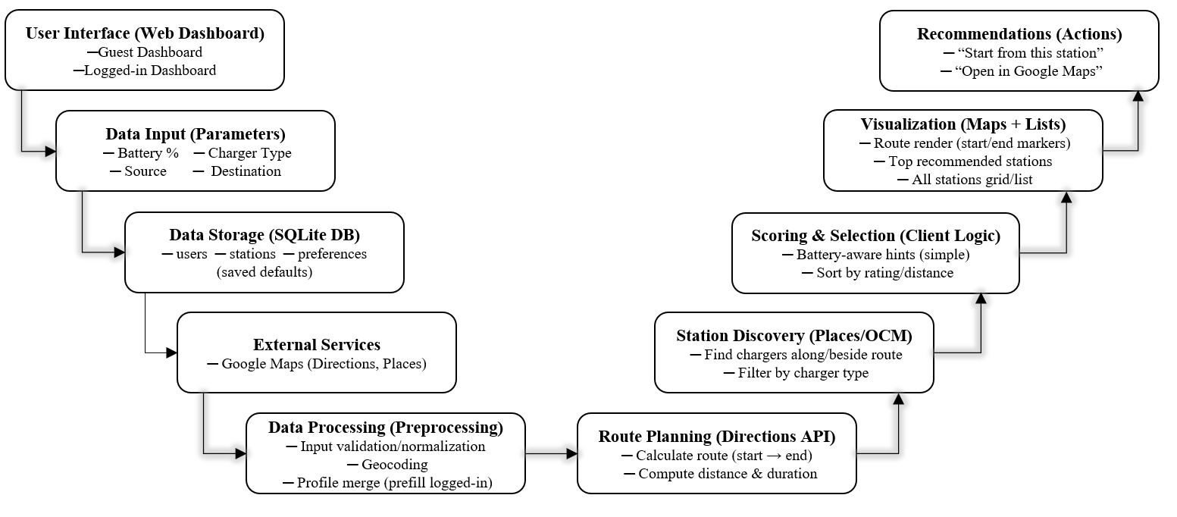
System Design

Slide 13
Technologies and methodologies
Technologies:
Frontend: HTML5, CSS (modern, responsive), vanilla JavaScript
Maps/Routing: Google Maps JavaScript API (Directions, Places)
Server (static hosting): Node.js (server.js)
Database: SQLite (evisionai.db), SQLAlchemy ORM
Methodologies:
1. Modular architecture separating UI, map services, and backend APIs
2. Progressive enhancement: guest flow first, logged-in flow with prefilled preferences
3. Client-side battery-aware heuristics for arrival SOC estimation
4. RESTful API design for auth, stations, and routing (extensible)

Slide 14
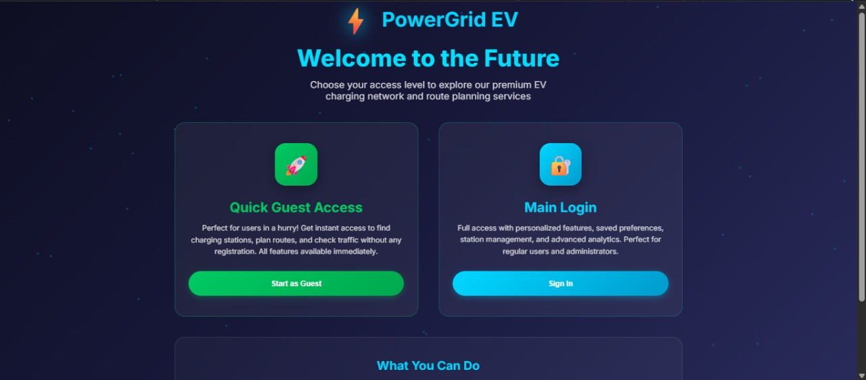
Implementation
welcome page with guest and login options

Slide 15
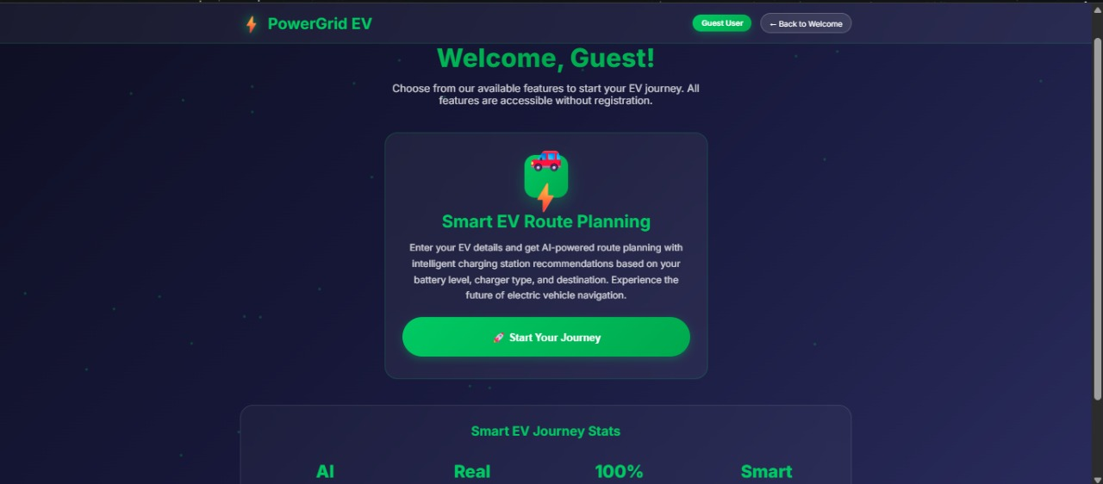
Implementation
Guest interface to start the journey

Slide 16
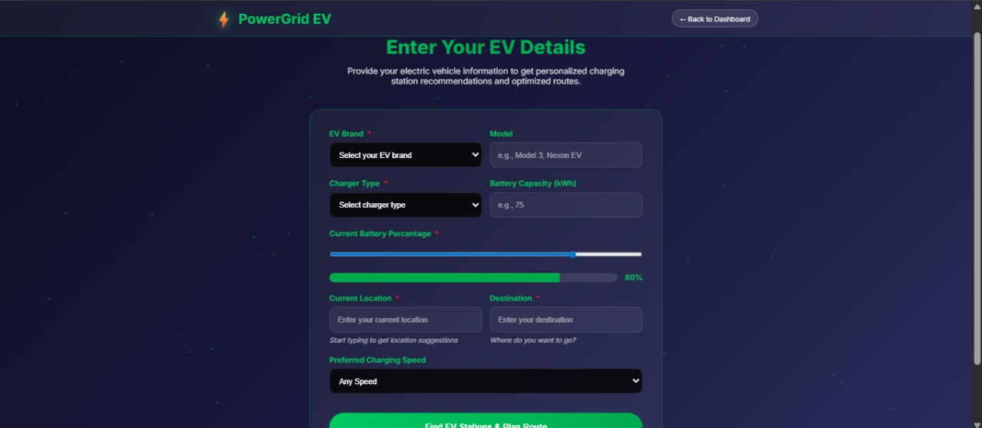
Implementation
options for guest to enter his/her EV Car details

Slide 17
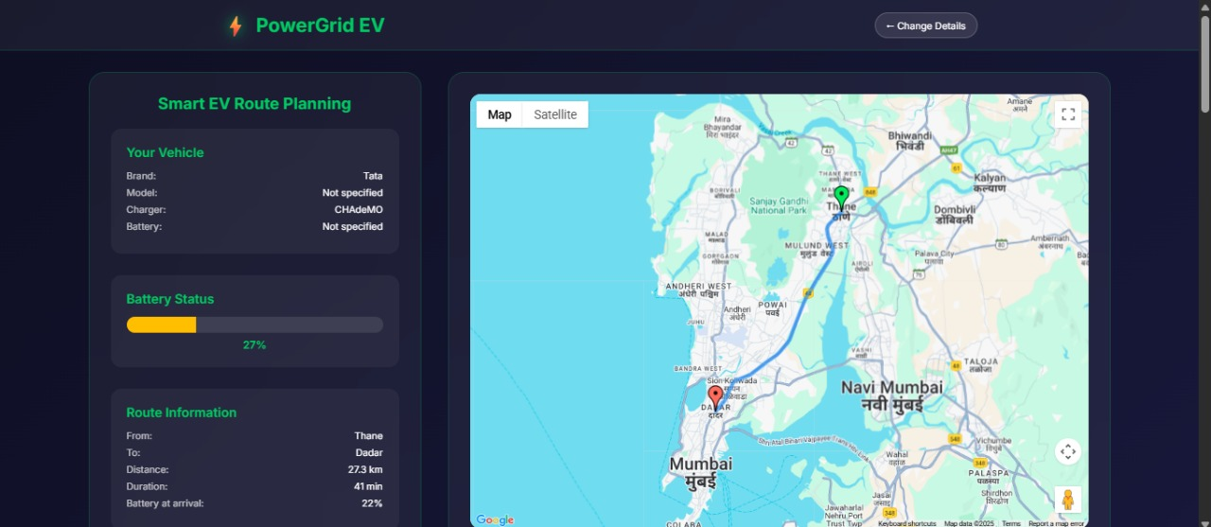
Implementation
map routing based on entered source and destination

Slide 18
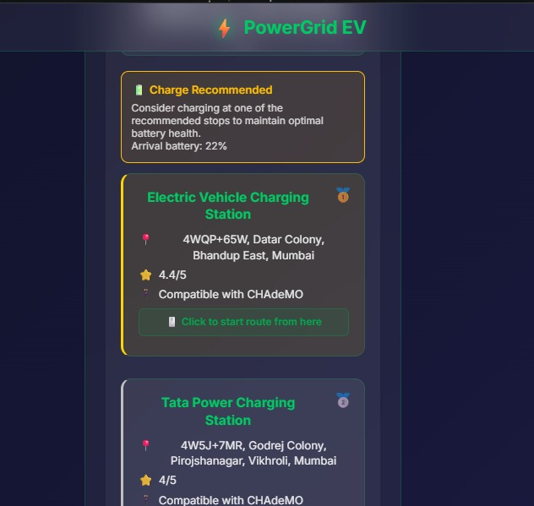
Implementation
EV Stations detection

Slide 19
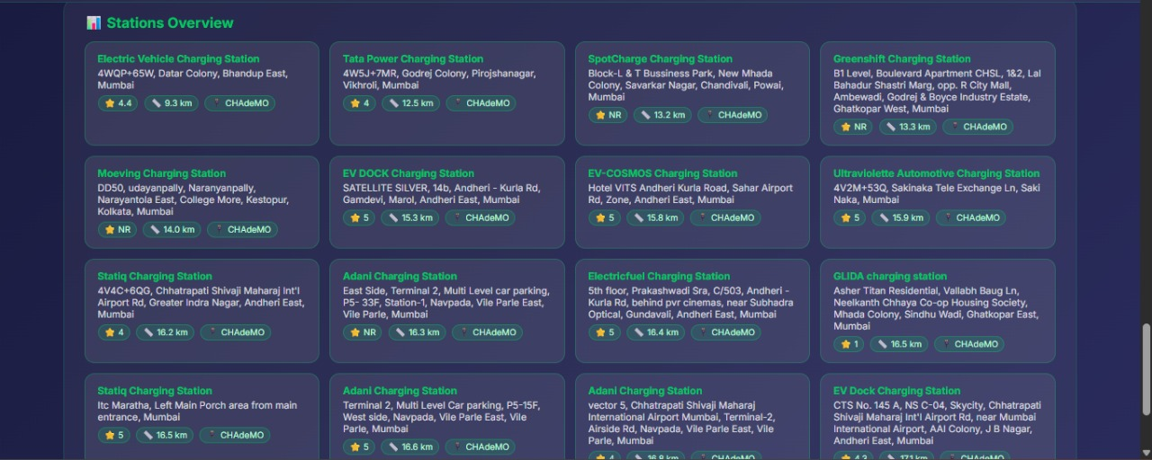
Implementation
overview of all detected EV Stations

Slide 20
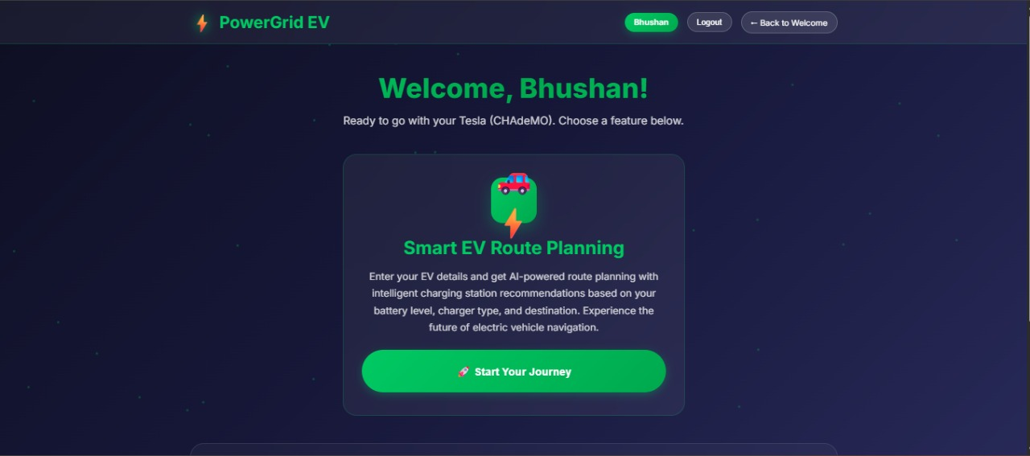
Implementation
login system to save data of user

Slide 21
Conclusion
EVisionAI integrates route planning and charging station discovery into a single platform, helping users reduce range anxiety and save travel time. It supports both guest and registered users, offering personalized features for convenience. With its simple, reliable, and user-friendly design, EVisionAI provides an efficient solution for electric vehicle trip planning.
Future Work :
1. Integration of real-time charging station availability from providers.
2. Support for multiple mapping APIs
3. Adding reservation system to pre-book charging slots.
4. Providing mobile app version for better accessibility.
5. AI-based smart suggestions for optimal routes and charging stops.

Slide 22
SDG ALIGNMENT
SDG 7 – Affordable and Clean Energy : Your project promotes the use of electric vehicles (EVs), which rely on clean energy instead of petrol or diesel.➡ Helps in spreading clean and renewable energy use.
SDG 11 – Sustainable Cities and Communities : By helping people find EV charging stations easily, the project supports eco-friendly transportation in cities.➡ Makes urban transport cleaner and more sustainable.
SDG 13 – Climate Action : Encouraging EV adoption helps reduce carbon emissions and air pollution, directly contributing to fighting climate change.➡ Reduces global warming effects.
SDG 9 – Industry, Innovation and Infrastructure EVisionAI uses AI and modern technology to improve transport infrastructure by locating charging stations and optimizing routes.➡ Builds smarter and more efficient transport systems.
SDG 17 – Partnerships for the Goals :The system can integrate with charging networks, map services, and government EV policies, promoting collaboration.➡ Encourages teamwork among tech companies, governments, and users for a greener future.

Slide 23
References
Research Papers :
[1] Stochastic modeling of multiple-server charging stations for electric vehicle(2024)--EV charging station modeling with multi-server queueing theory and feedback control
[2] Electric Vehicle charging station load forecasting with an integrated DeepBoost approach(2025)--EV charging station load forecasting
[3] Planning of electric vehicle charging stations: An integrated deep learning and queueing theory approach(2024)-- EV charging station location-capacity planning using deep learning and queueing theory
[4] An Intelligent System for Electric Vehicle Charging Station Discovery and Reservation Using Real-Time Data(2025)--EV charging infrastructure with real-time station discovery and slot reservation
URLS :
[1]:https://doi.org/10.1109/ICSSAS66150.2025.11080835
[2]:https://doi.org/10.1016/j.tre.2024.103568
[3]:https://doi.org/10.1016/j.aej.2024.12.069
[4]:https://doi.org/10.1016/j.ijft.2024.100859

Slide 24
Thank You...!!

